Slide 1
Logesh D
Final Project
3/21/2024 Annual Review

Slide 2
OBJECT DETECTION USING R-CNN
3/21/2024 Annual Review

Slide 3


AGENDA
Problem Statement
Define the challenge of object detection.
Highlight limitations of traditional methods.
Project Overview
Briefly outline project goals and methodology.
End Users
Identify target audience and their benefits from the solution.
Your Solution and Value
Introduce R-CNN and its advantages.
Highlight its superiority over traditional methods.
The Wow Factor
Showcase unique features and benefits of your solution.
Modelling
Explain R-CNN architecture briefly.
Results
Present quantitative and qualitative results of object detection.
3/21/2024 Annual Review

Slide 4

PROBLEM STATEMENT
The problem at hand is the need for an advanced object detection system that can accurately and efficiently identify objects in images or video, particularly in complex scenes with multiple objects of various sizes and orientations. Traditional methods often struggle with accuracy and speed, and they lack the ability to provide detailed information such as segmentation s. To address these limitations, we aim to develop a robust solution leveraging cutting-edge deep learning techniques, specifically R-CNN. By doing so, we aim to provide a high-performing object detection system capable of delivering precise localization and segmentation results in real-time, thereby enhancing applications across multiple domains that rely on accurate object understanding and localization.
3/21/2024 Annual Review

Slide 5

PROJECT OVERVIEW
In this project, I'm focusing on implementing an object detection system using R-CNN, a cutting-edge deep learning architecture. R-CNN extends the Faster R-CNN framework by adding a branch for predicting segmentation s alongside the existing branch for object detection. This allows for simultaneous object detection and instance segmentation, providing detailed information about the objects detected in an image.
My goal is to leverage the capabilities of R-CNN to achieve accurate and efficient object detection in various real-world scenarios. I will train and fine-tune the model on a dataset suitable for our application domain and evaluate its performance using standard metrics. Ultimately, this project aims to demonstrate the effectiveness of R-CNN in addressing the challenges of object detection and segmentation, paving the way for its practical deployment in diverse applications such as autonomous vehicles, surveillance systems, and medical imaging.
3/21/2024 Annual Review

Slide 6

WHO ARE THE END USERS?
Autonomous Vehicles: Autonomous vehicle manufacturers rely on our system for accurate object detection, enabling safe navigation and obstacle avoidance. By seamlessly integrating our technology, they can enhance the reliability and efficiency of self-driving cars, ensuring passenger safety in diverse road conditions.
Surveillance Systems: Security firms leverage our object detection capabilities to monitor and track suspicious activities, bolstering public safety and crime prevention efforts. With our system, they can effectively identify and respond to potential threats, safeguarding critical infrastructures and public spaces.
Healthcare: Medical professionals trust our system for precise object detection in medical imaging, facilitating early diagnosis and treatment planning for various diseases. Our technology empowers healthcare providers to deliver personalized and effective interventions, improving patient outcomes and quality of care.
Retail: Retailers utilize our object recognition system to streamline inventory management and enhance customer experiences. By accurately identifying products and analyzing customer behavior, they can optimize stock levels, increase sales, and offer personalized recommendations, thereby fostering customer loyalty and satisfaction.
Manufacturing: Manufacturing companies integrate our object detection technology into their automation processes to ensure product quality and efficiency. By detecting defects and monitoring production lines in real-time, they can minimize errors, reduce downtime, and maximize productivity, ultimately driving cost savings and competitiveness in the market.
3/21/2024 Annual Review

Slide 7

YOUR SOLUTION AND ITS VALUE PROPOSITION
My solution stands out for its utilization of R-CNN, a cutting-edge deep learning architecture renowned for its unmatched accuracy and efficiency in object detection. By incorporating this state-of-the-art technology, I offer a comprehensive solution that not only identifies objects but also precisely segments them, providing detailed insights crucial for diverse applications. This approach ensures superior performance and reliability across industries, empowering organizations to make informed decisions and achieve their objectives with confidence.
3/21/2024 Annual Review

Slide 8

THE WOW IN YOUR SOLUTION
What sets my solution apart is its utilization of R-CNN, a groundbreaking deep learning architecture known for its unparalleled accuracy and efficiency in object detection and segmentation. This innovative approach allows me to provide detailed and precise information about detected objects, going beyond traditional methods to deliver exceptional results. By harnessing the power of R-CNN, I enable my solution to excel in diverse applications, from autonomous vehicles to medical imaging, revolutionizing how organizations perceive and interact with their environments.
3/21/2024 Annual Review

Slide 9
MODELLING
Model Selection: I chose the R-CNN architecture as the foundation for my object detection model, leveraging its advanced capabilities for accurate detection and segmentation.
Data Preparation: I meticulously curated and preprocessed the dataset, ensuring it was well-annotated, diverse, and appropriately partitioned into training, validation, and test sets.
Training Configuration: I carefully configured the training parameters, including learning rate, optimizer, batch size, and number of epochs, to optimize model convergence and performance.
Training and Fine-Tuning: I executed the training process, monitoring performance metrics closely and fine-tuning the model as needed to enhance accuracy and generalization.
Evaluation: I rigorously evaluated the trained model's performance on the test set, employing standard metrics such as mean Average Precision (mAP) and Intersection over Union (IoU) to assess its efficacy and identify areas for improvement.
3/21/2024 Annual Review

Slide 10
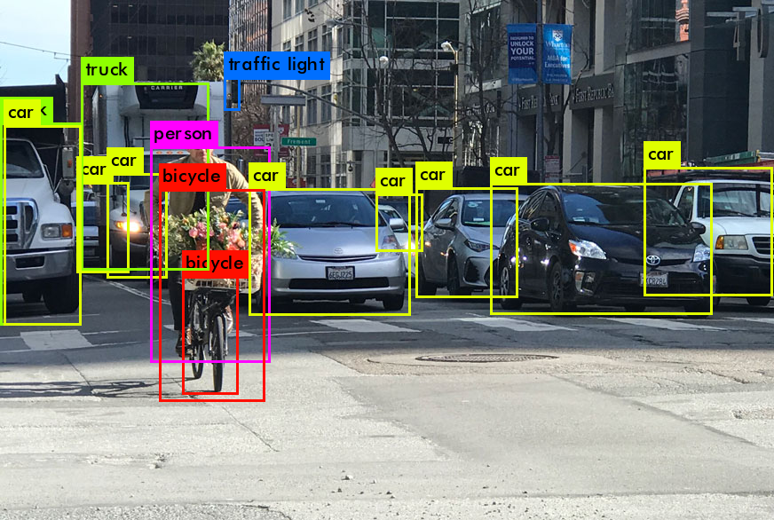
RESULTS
Demo Link
3/21/2024 Annual Review

